Slide 1

Restaurant Recommender Systems
Gaurang Rathod, Prashanth Palaniswamy, Prithvi Vihari Ramesh Rao

Slide 2







Success Stories

Slide 3
Objective
Predict the rating that the user would give to a restaurant by making use of restaurant information data, user details data and previous rating data
Approach
Use various collaborative filtering, matrix factorization and Content-based filtering algorithms
Individually evaluate each algorithm and ensemble various algorithms with good result, find which combination works the best
We show step by step increase in accuracy by using various combinations

Slide 4
Data Preparation
Data source:
https://archive.ics.uci.edu/ml/datasets/Restaurant+%26+consumer+data
Format of dataset used for collaborative filtering & matrix factorization:
A total of 1153 rows
Same train and test data set used for all the evaluations.
The dataset used for content based filtering has 1153 rows and 255 columns. It has restaurant data (placeID, location, payment type, cuisine, hours of operation, parking details, ratings, etc.), and user data (userID, age, personal details, lifestyle details, payment mode, etc.).
userID | placeID | rating

Slide 5
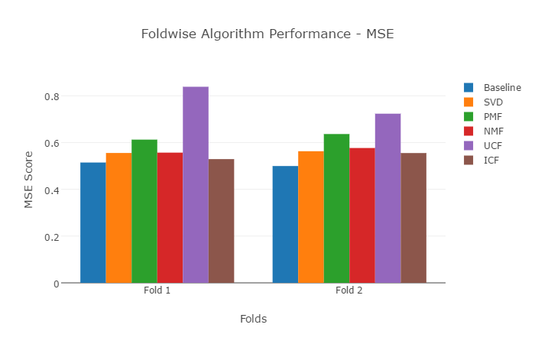
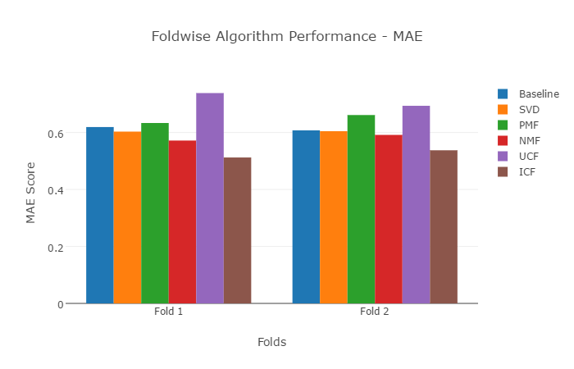
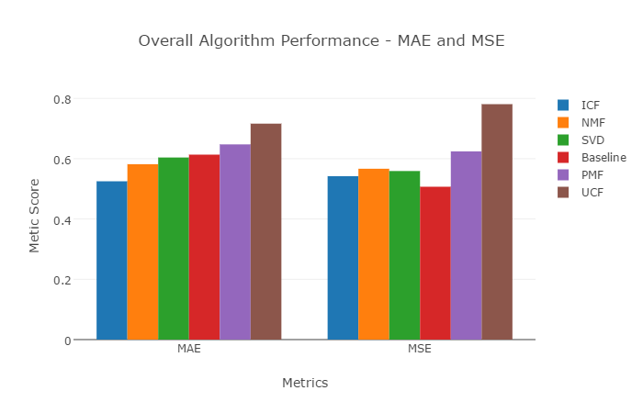
Comparing CF and MF algorithms individually
Evaluating the performances of 6 algorithms- Baseline, SVD, PMF , NMF , UCF , ICF.
we can observe from the analysis that ICF, SVD and Baseline are the top performing algorithms.

Slide 6
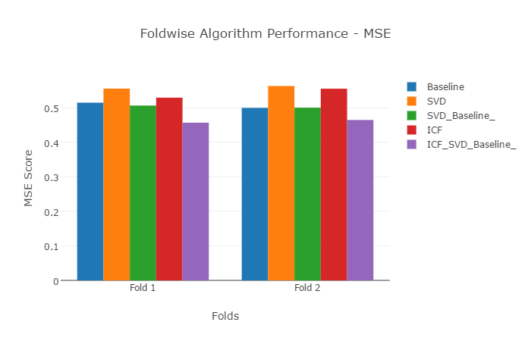
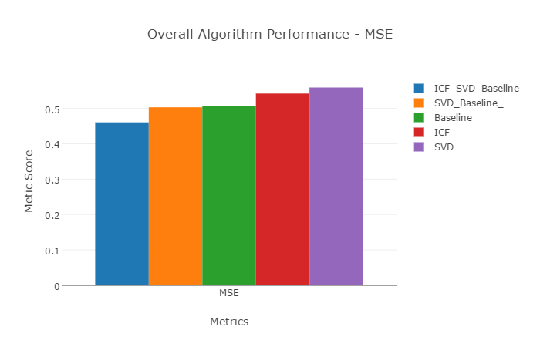
Ensembling CF and MF Algorithms
From this analysis, we observed that by ensembling multiple CF algorithms the accuracy increases.
By ensembling Baseline, ICF and SVD algorithms, the accuracy increased by 9.15% to that of the best individual CF, MF algorithm.

Slide 7
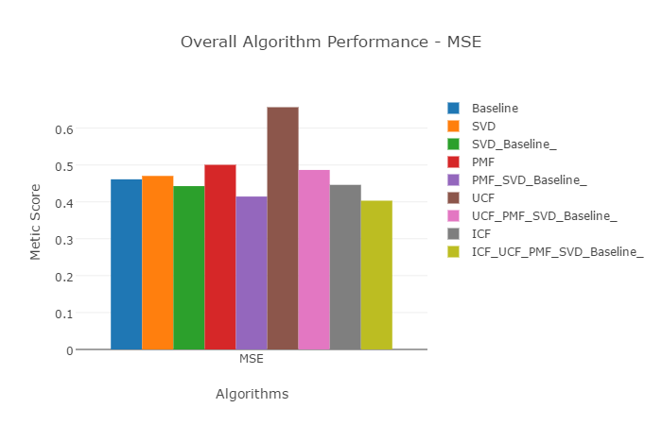
Continued..
By ensembling the best CF and MF algorithms, it was found that the accuracy percentage Increased by 9.61 %.

Slide 8
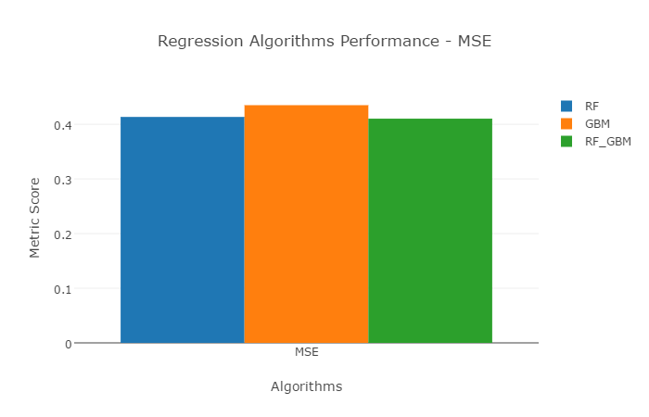
Content Based Recommendation algorithms Using Regression Modelling
We observed that content based recommendation algorithms outperformed even the ensembled CF algorithms, the improvement percentage is 10.9%.
This result was expected for this dataset as we use more fields to predict the rating.

Slide 9
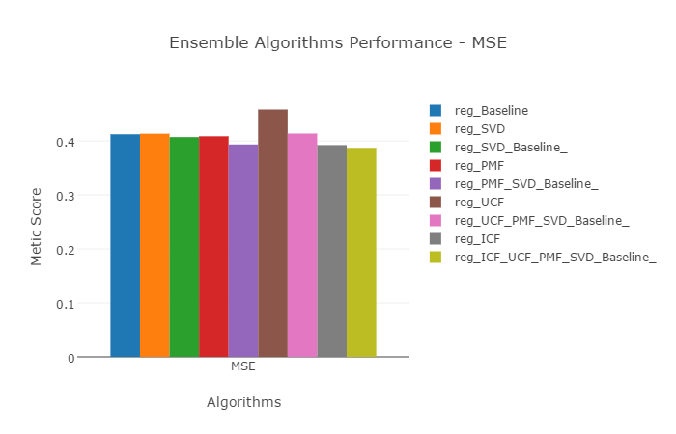
Ensembling the best Content Based, CF and MF algorithms
By including the regression model to predict the ratings using the user and item attributes to CF and MF models, we are able to increase the accuracy even further by 13.2%.

Slide 10
Impact of food and service rating on the overall rating using regression modelling
By including the food and service ratings in content based regression, we get a whopping 45% increase in the accuracy of the final rating.

Slide 11

Ensembling content based (food, service rating included) with CF, MF algorithms
Ensembling the model is now deleterious, as the content based method has the information of food and service ratings, the MF and CF methods do not.

Slide 12
Conclusion
The improvement in accuracy by using various combinations of CF, MF and content based algorithms was analyzed and shown incrementally
When food and service rating was considered in the regression model, the accuracy of overall rating prediction improved significantly
Future
Try more approaches in content based filtering algorithms.
Try several other ensemble combinations to see if it performs better.

Slide 13
Thank you!

